Slide 1

CoCo - Core Course Scheduling
Who we are:
Study coordination and administration
of the Computer Science department
What we need:
Automated Core Courses Scheduling:
web based
browser independent
interactive GUI

Slide 2
CoCo - Core Courses CS
All our core courses (at least every two years offered)
Algorithms and Data Structures Data Networks
Artificial Intelligence Operating Systems Semantics
Automated Reasoning Distributed Systems
Compiler Construction Complexity Theory Optimization
Computer Algebra Computer Architecture Machine Learning
Computer Graphics Embedded Systems Cryptography
Information Retrieval and Data Mining Data Base Systems
Software Engineering Telecommunications
Image Processing an Computer Vision Security
Geometric Modelling Computational Logic Verification
6 - 12 core lectures per semester to be coordinated

Slide 3
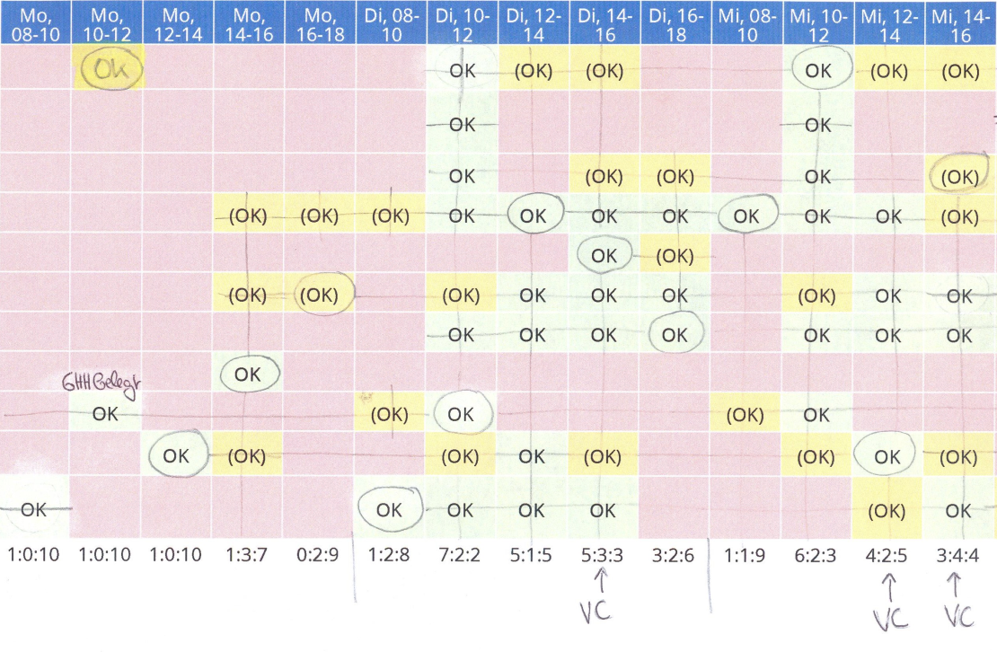
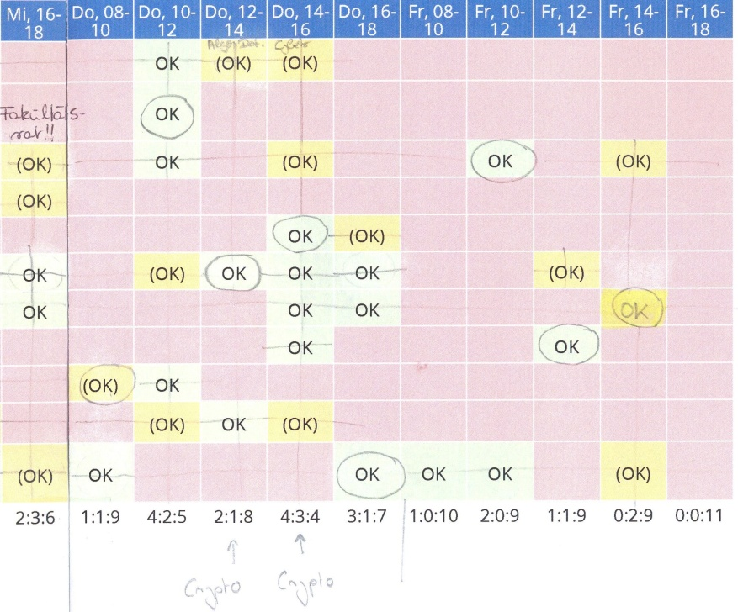
CoCo – Example constraints
Lecturers wishes
No overlap of core lectures
Core lecture 1
Core lecture 2
…
Core lecture 11
No overlap of courses belonging
to the same field, e.g. VC
Estimated number of participants/
Availability of lecture halls
At least one working day
between the lectures

